Slide 1
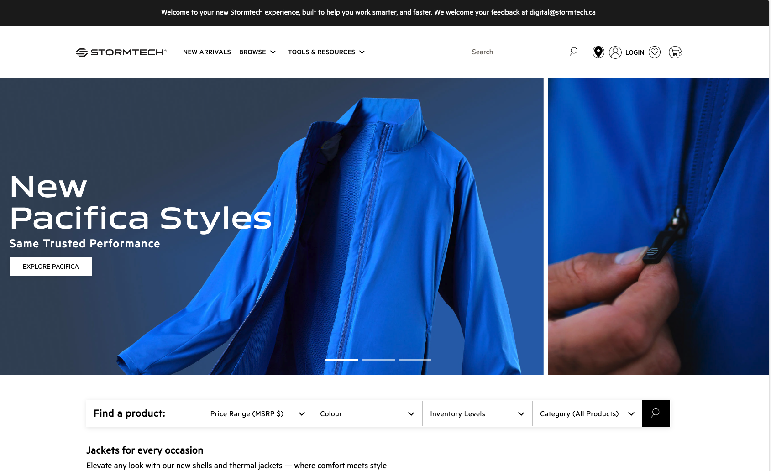
https://www.stormtechperformance.com/
They focus on the Price range, Colour, Inventory Levels and Category.
Interesting and obvious B2B focus for buyers.

Slide 2
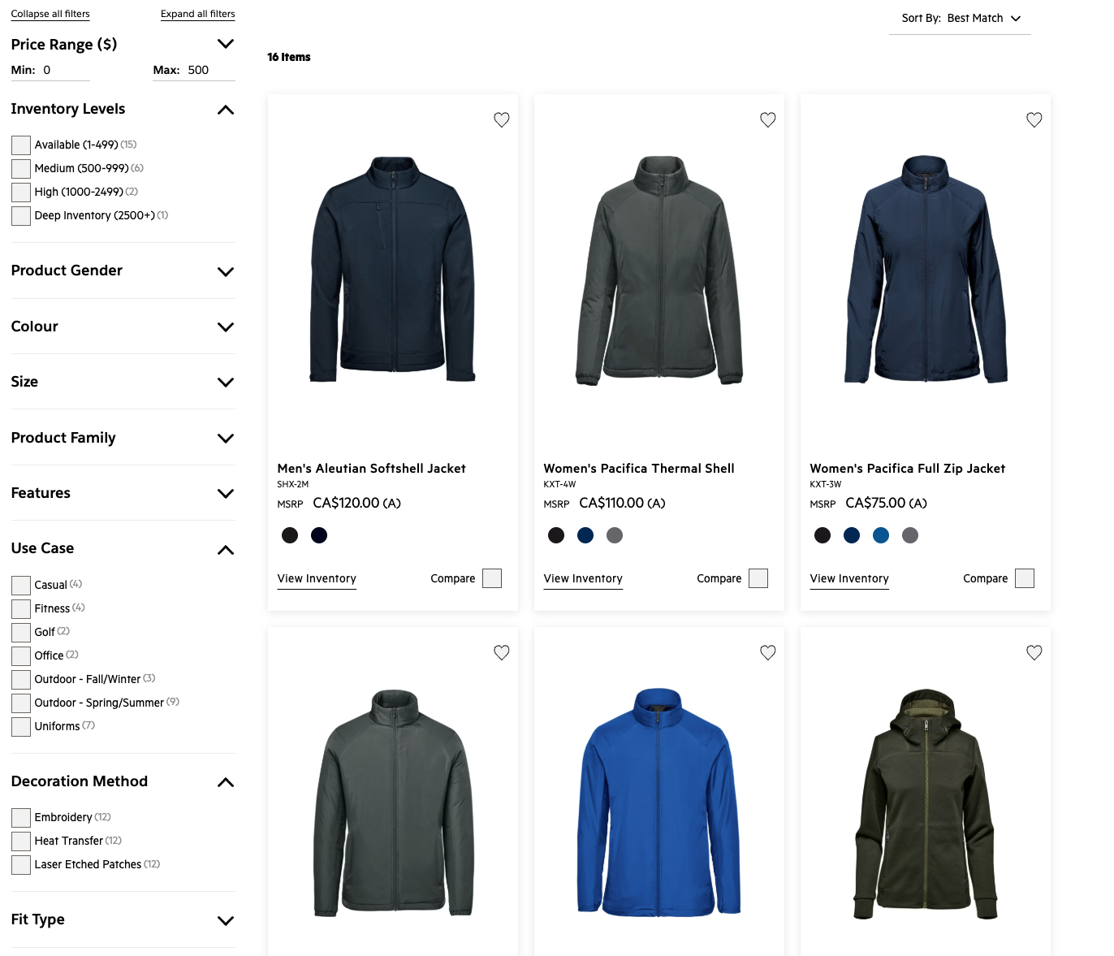
Again, good focus for buyer intent and what users look for.
Is “Deep inventory” the right term?

